Slide 1

Highlights from Exploratory Analysis of Brussels United FC
Business Problem:
To hire players for the newly inaugurated football club named “Brussels United FC” based on data.
Aim : To analyze and select the best football players according to the specific requirements provided, in order to constitute a team.
Query:
For a newly constituted football club in Europe, what would be the best combination of players that the club may hire. Which players are the best as per provided criteria?
Data Available:
Fifa.csv, which had data of over 18000 players from Europe was used to perform Exploratory Analysis for Brussels United FC.

Slide 2
Highlights from Exploratory Analysis of Brussels United FC
Path Followed:
Use fifa.csv to get the data of 18000 players.
Dropping out unwanted columns from the input data.
Cleaning of Data for specific columns.
Dealing with missing values and replacing them with the mean wherever required.
Visualize the distribution of Overall rating and also generate pair plots for specified columns.
Performing Exploratory Analysis to generate Top 20 players based on specified conditions.
Performing Exploratory Analysis to generate Top 5 players based on each position.

Slide 3
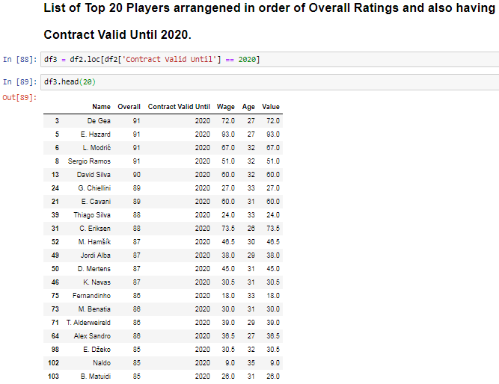
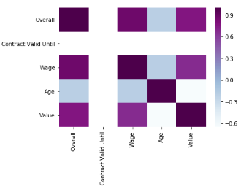
Highlights from Exploratory Analysis of Brussels United FC
Results:
Top 20 Players based on Overall Ratings and whose contract with their respective clubs end in 2020.
Average Wage of the top 20 players is €206.4k
The mean Age of these Top 20 players is 30.6 years, while the mean age of all 18000 players is 25.236 years.
Yes there is a fare bit of correlation between Overall Rating and Value of the Top 20 players.

Slide 4
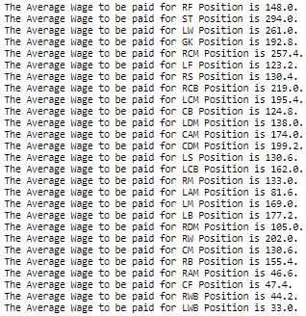
Highlights from Exploratory Analysis of Brussels United FC
Results:
Top 5 Players based on Overall Ratings and for each position were L Messi,Christiano Ronaldo, Neymar Jr, De Gea and K Debruyne.
None of the players occur in more than 1 table.
The average wage for each position has been specified in the image.

Slide 5
Highlights from Exploratory Analysis of Brussels United FC
Discussion:
The average age of the top 20 players is 30.6 years, whereas the highest age is 35 years .
Clearly the top 20 players that are shortlisted based on the overall rating and contract deadline of 2020 could not be the best fit for Brussels United FC.
Recommendation:
Overall rating and Position based player selection could be the best option for the club to hire a particular player.
This will not only ensure that you have the high ranking players but also ensure that you have option of selecting a player who is much younger and this may also impact the overall expenditure of the club.

